Slide 1
Beer Case Study EDA
Pejal Rath and Kyle Kuberski

Slide 2

Introduction
P

Slide 3
Data Overview
The Beers dataset contains a list of 2410 US craft beers and Breweries dataset contains 558 US breweries.
Beers.csv:
Name: Name of the beer.
Beer_ID: Unique identifier of the beer.
ABV: Alcohol by volume of the beer.
IBU: International Bitterness Units of the beer.
Brewery_ID: Brewery id associated with the beer.
Style: Style of the beer.
Ounces: Ounces of beer.
Breweries.csv:
Brew_ID: Unique identifier of the brewery.
Name: Name of the brewery.
City: City where the brewery is located.
State: U.S. State where the brewery is located.
P

Slide 4
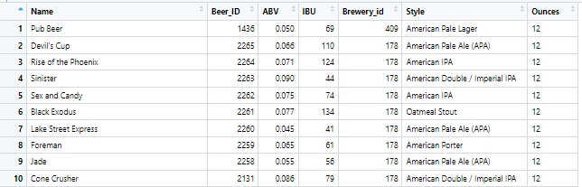
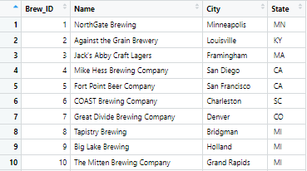
Sample Data
Beer
Brewery
P

Slide 5
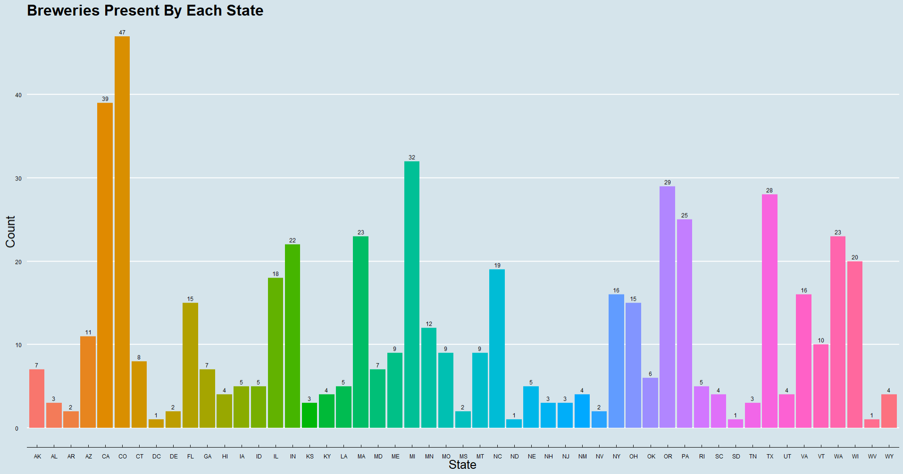
Breweries Present By Each State
P

Slide 6
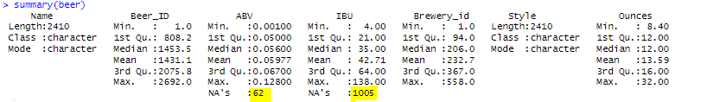
Address The Missing Values
P

Slide 7
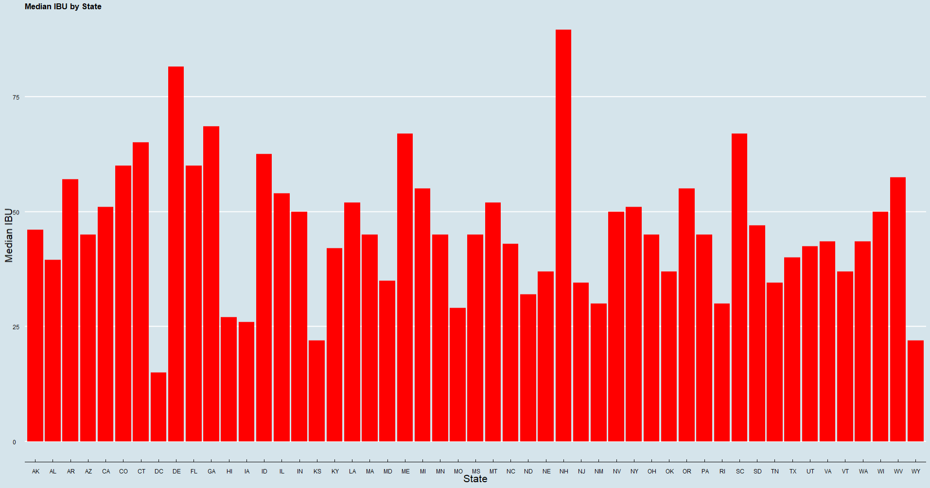
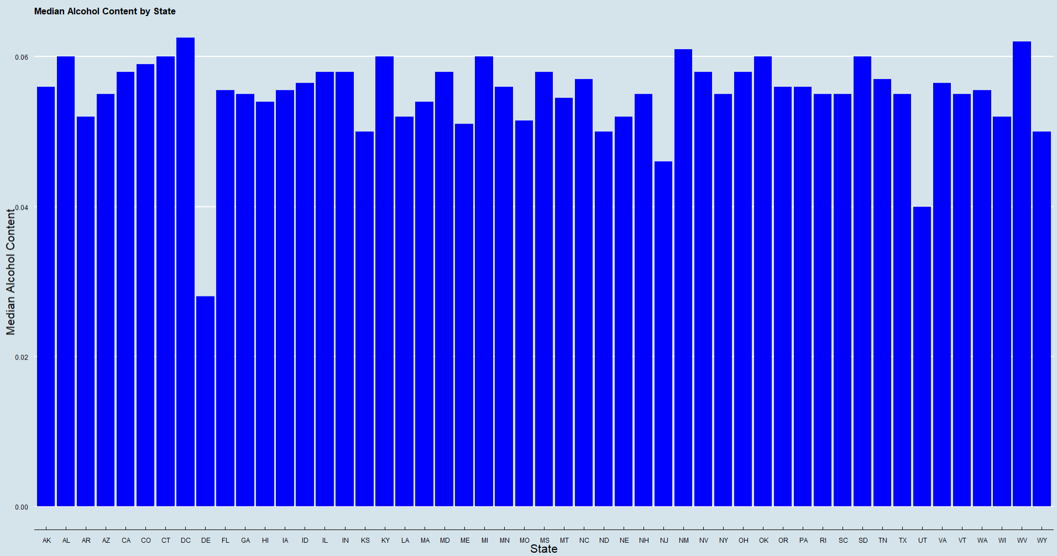
The Median ABV & IBU For Each State
P

Slide 8
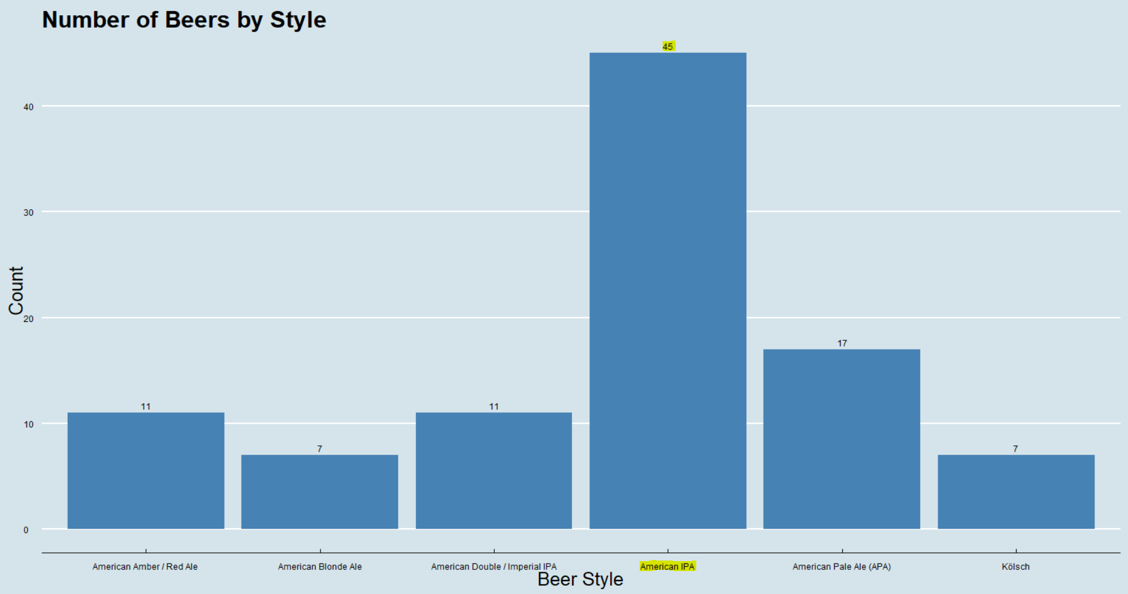
California

Slide 9
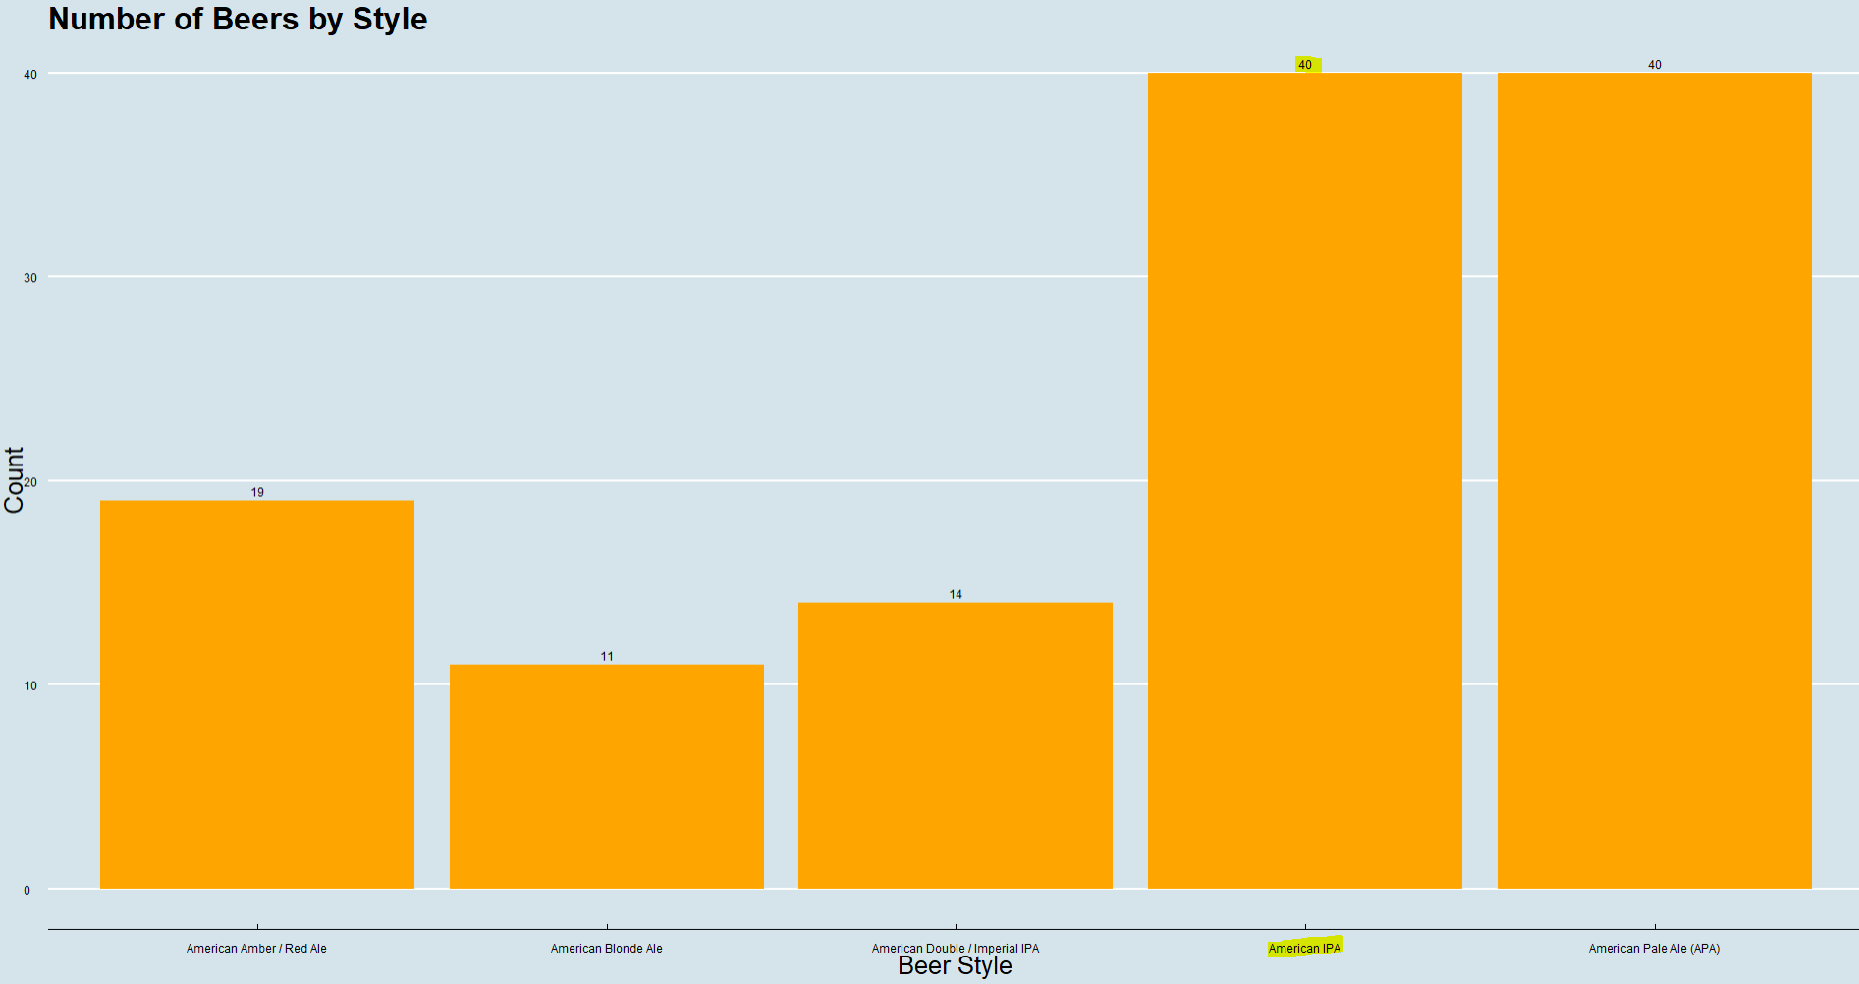
Colorado

Slide 10
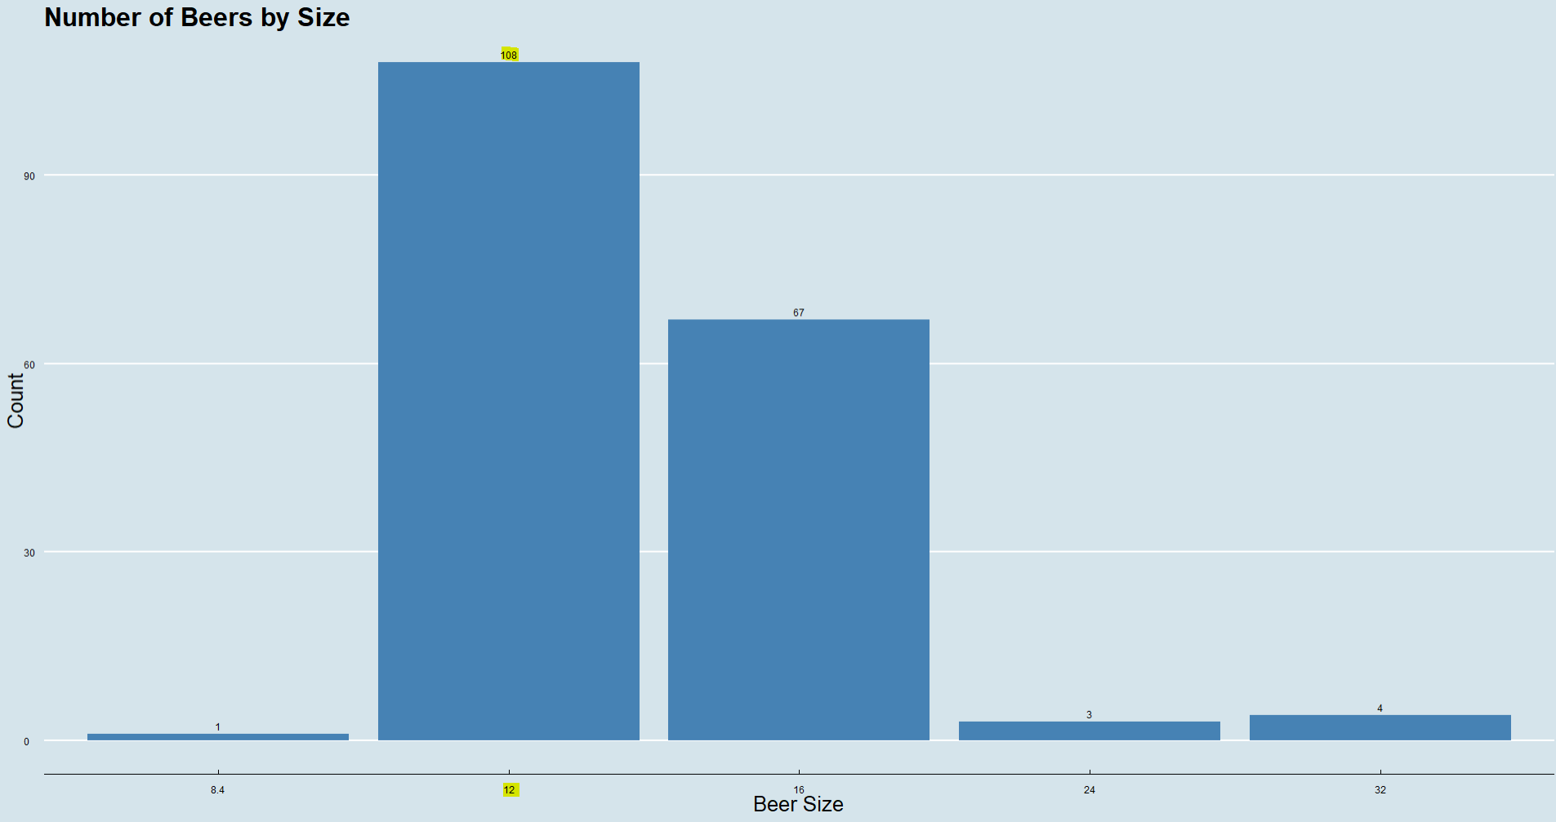
California

Slide 11
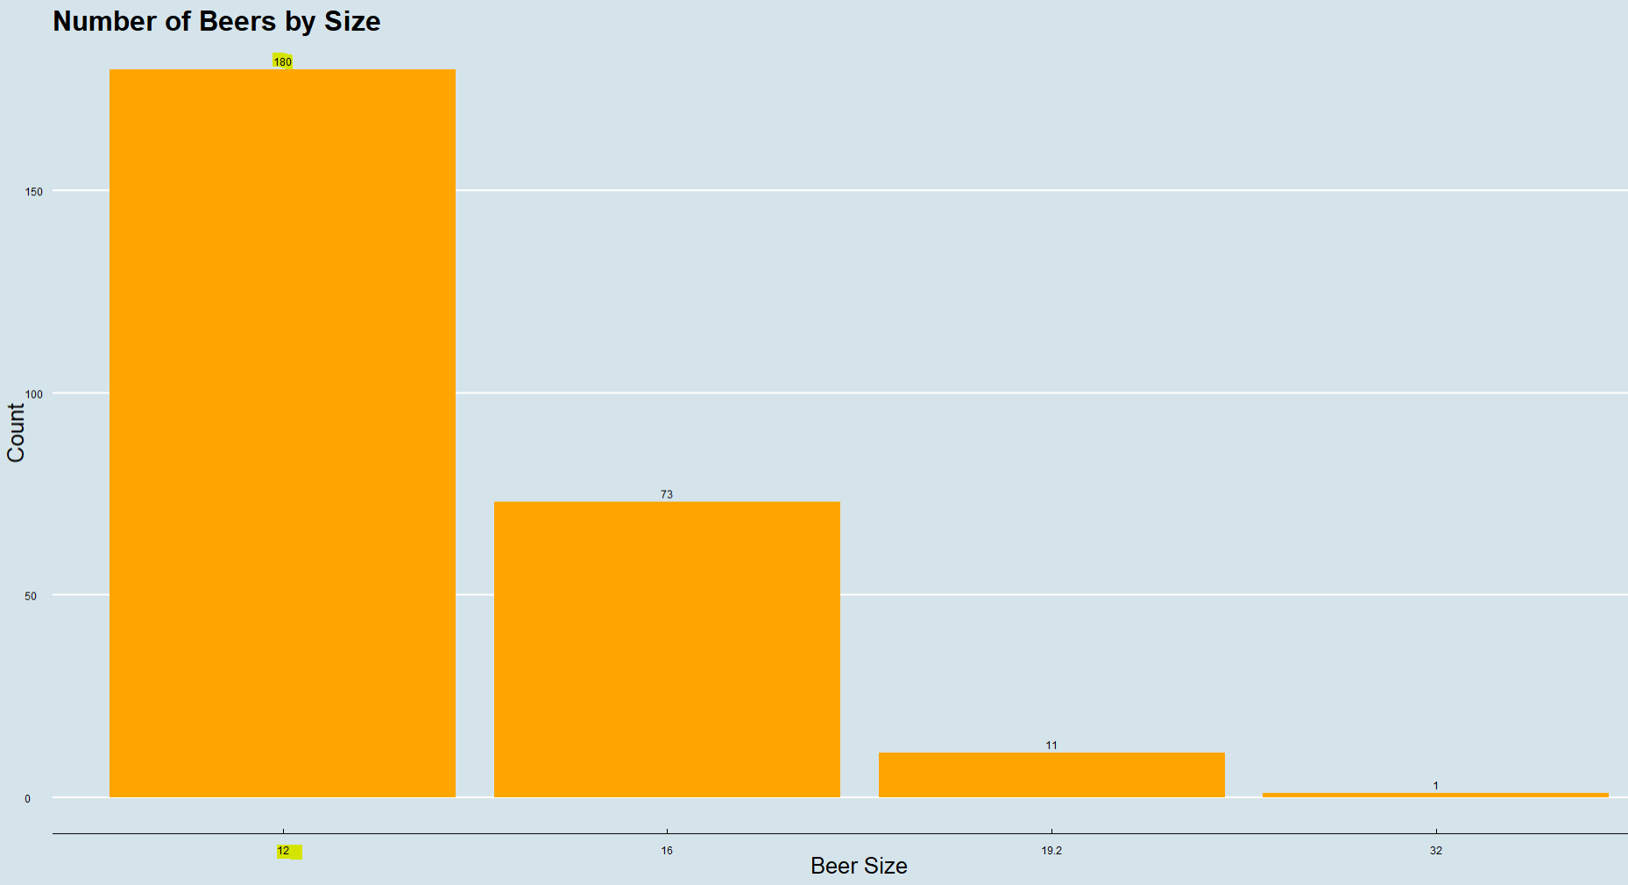
Colorado

Slide 12
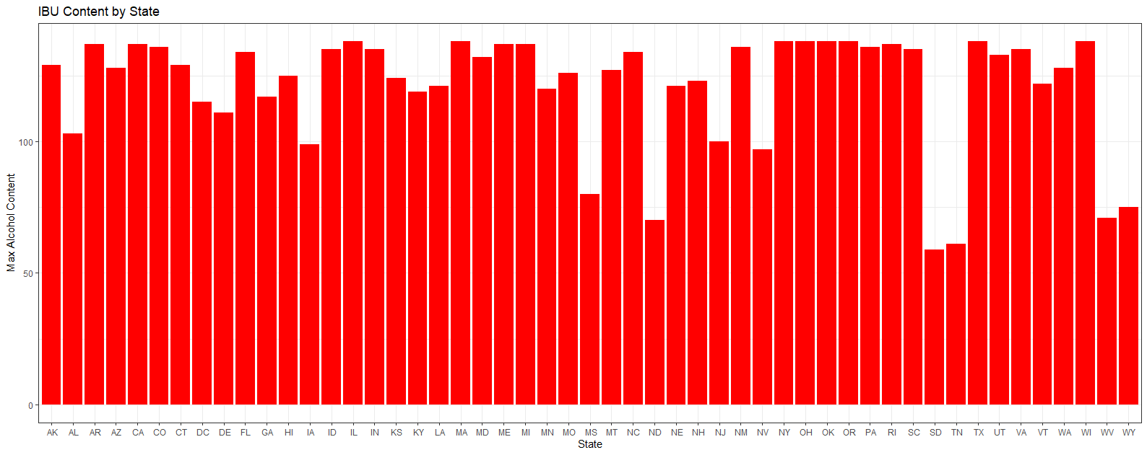
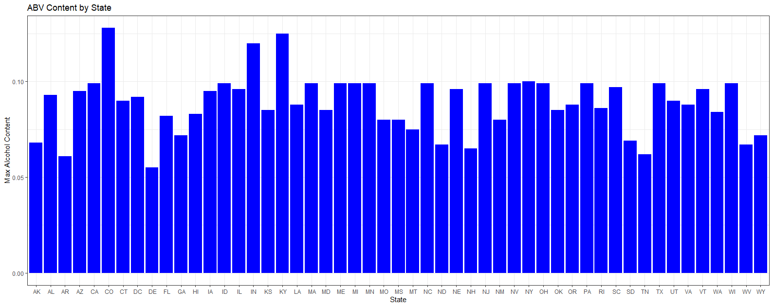
Max ABV and IBU Content (Per State)
New York has the highest IBU content
Brewery:
Sixpoint Craft Ales
Beer Name:
Abigale – IBU: 138
Colorado contains the highest ABV content:
Brewery:
Upslope Brewing Company
Beer Name:
Lee Hill Series Vol. 5 - Belgian Style Quadrupel Ale – ABV: 0.128
K

Slide 13
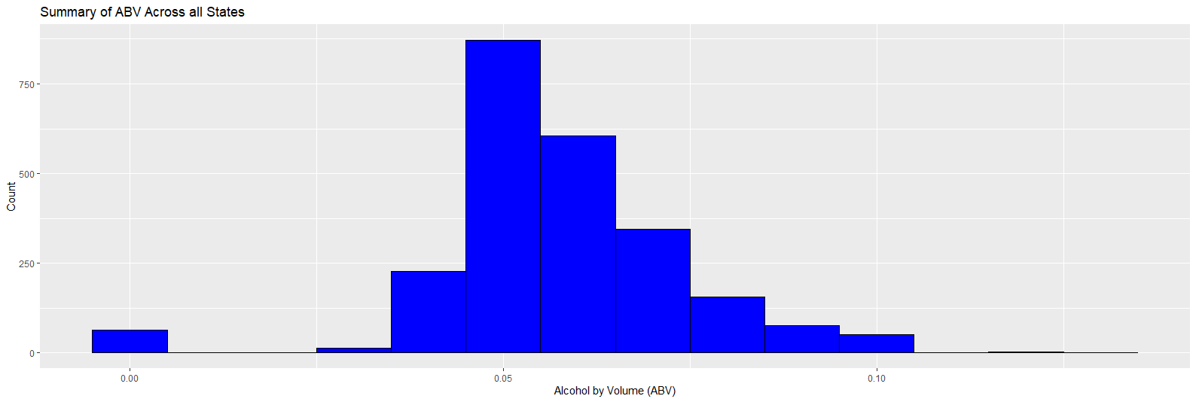
Summary Statistics & Distribution of ABV
5 Number Summary:
Min | 1st Quartile | Median | 3rd Quartile | Max
0.00100 | 0.05000 | 0.05600 | 0.06700 | 0.12800
Mean​
0.05826​
K

Slide 14
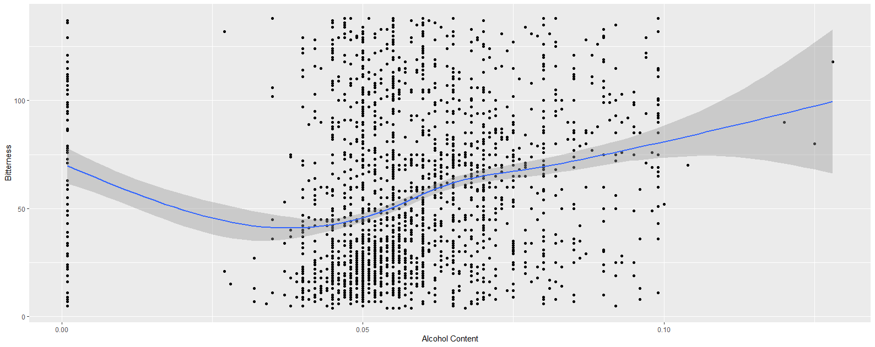
Relationship Between ABV and IBU
Generally, there is a positive correlation between bitterness and alcoholic content
As alcoholic content increases (ABV),
beer bitterness (IBV)
may tend to increase as well
K

Slide 15
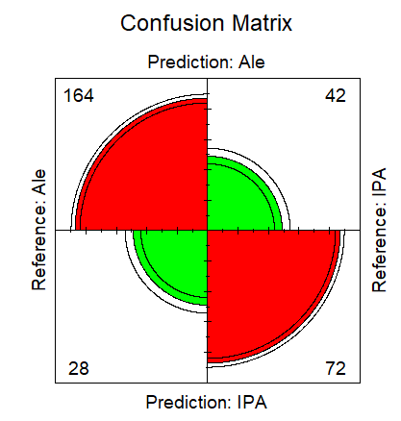
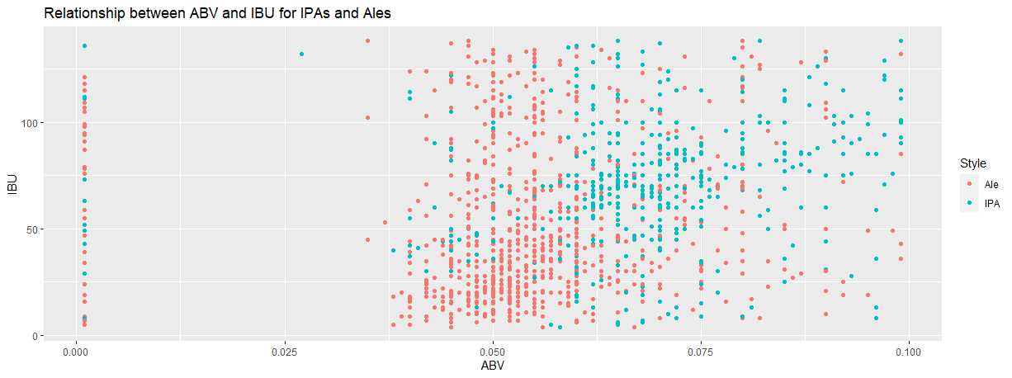
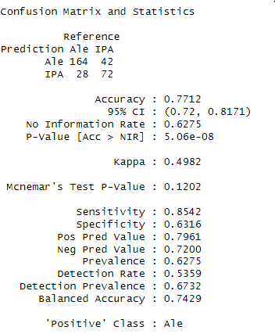
ABV & IBU Relationship (IPAs v Ales)
IPA
Ale

Slide 16
Thank You For Your Time!
Sources:
https://github.com/BivinSadler/MSDS_6306_Doing-Data-Science/tree/Master/Unit%208%20and%209%20Case%20Study%201
Email:
Kkuberski@smu.edu
Prath@smu.edu
Video Link:
https://www.youtube.com/watch?v=n_1GuTjdLbc&ab_channel=KyleKuberski

